Slide 1
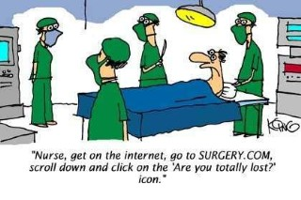
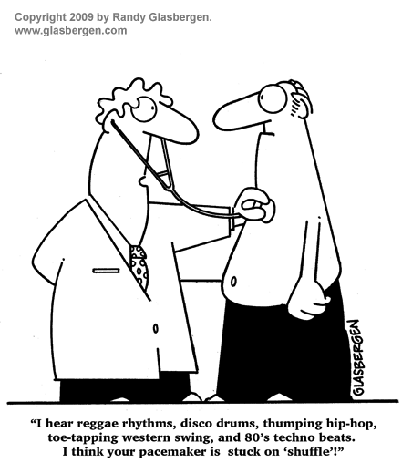
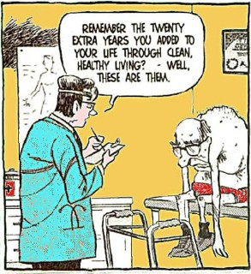
Notes:
Images copyright as indicated;
Otherwise, google stock images

Slide 2
Cardiology Diagnostics Finale
Diagnostic Medicine I - Fall 2020
Prepared by: Matt Ewald, MPAS, PA-C

Slide 3
Objectives:
By the end of this class, you should be able to:
Have a better understanding of the indications (and/or contraindications when applicable) for use of Tilt Table Testing, Endocardial Biopsy, and Cardiac PET/SPECT Scan
Apply acquired knowledge to presented clinical or case scenarios and appropriately determine when to order these diagnostic tests.
Understand limitations to these diagnostic tests (if any) and any available strategies to mitigate the effect of these limitations on diagnosis of disease states.

Slide 4
Class Preview
This class will cover:
Tilt Table Testing
Endocardial Biopsy
Cardiac PET/SPECT Scan
Brief review of indications/contraindications in ECHO

Slide 5
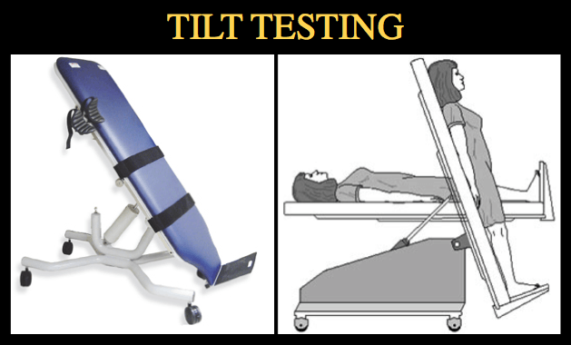
Tilt Table Testing

Slide 6
Pathophys Behind the Testing
Gravitational shifts in blood volume are a recognized source of neuro-cardiogenic syncope
(called vasomotor, vasovagal, neural-mediated or neurocardiogenic syncope)
Normal activation of baroreceptor vaso-motor reflex should temporarily increase HR and cause vasoconstriction to offset gravitational shift in blood to prevent syncope
Using a table that can tilt from flat to upright, (in theory) can incite / provoke symptoms that are caused by gravitational (positional) changes.
Notes:
MAP = mean arterial pressure

Slide 7
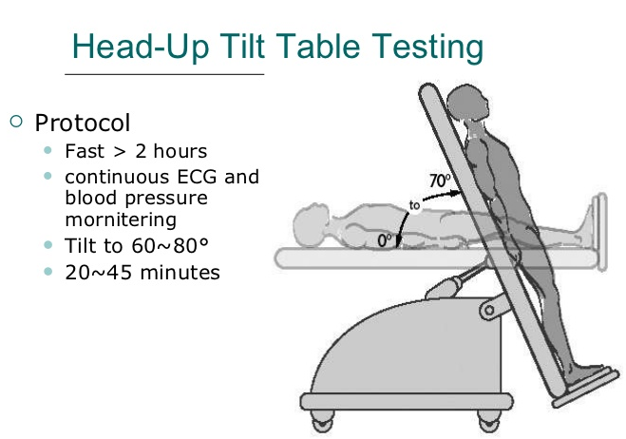
Process of Tilt Testing:
The technique involves monitoring a patient in several positions.
The patient starts horizontal (~10 mins of monitoring), then proceeds to the tilt portion, where table is at 60-80 degree angle for 20-45 mins.
Monitoring includes BP cuff, O2 saturation monitor, Continuous ECG.
In a normal test, you would see temporary slight decrease in systolic BP, with slight increase in diastolic BP, and HR.

Slide 8
Indications:
Recurrent episodes of syncope after emergent cardiac causes of syncope have been excluded.
Unexplained syncopal episode in a high-risk settings (ie potential risk for physical injury or occupational hazard).
Such as a heavy machinery operator
To demonstrate susceptibility to reflex syncope to the patient
Such as for documentation as in occupational, sports, insurance, or other purposes
Diagnosis of Postural Tachycardia Syndrome (POTS)
Notes:
POTS = Postural tachycardia syndrome (POTS) is defined as a form of orthostatic intolerance characterized by an excessive increase in heart rate that occurs on standing without arterial hypotension

Slide 9
Abnormal Results
Result of this test can help distinguish between etiologies of syncope.
Tilt table testing is considered positive if:
Syncope or pre-syncope occurs with hypotension, with or without bradycardia
Bradycardia alone (less common)
Hypotension alone
Test is negative if after the full monitoring period, there are no abnormal results.

Slide 10
Considerations/Limitations
The test is reproducible and has high specificity with a low false-positive rate
But, sensitivity can vary significantly
20-80% depending on population assessed
However: Routine use of tilt-table testing for undiagnosed syncope etiology evaluation is not recommended per AHA/ ACCF guidelines
There is, however, usefulness for this test in patients after routine cardiac and neurologic evaluation is unrevealing
Notes:
AHA/ACCF = American heart associated/American college of cardiology foundation

Slide 11
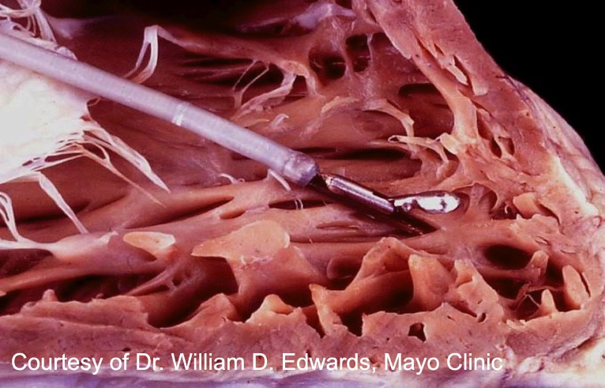
Endomyocardial Biopsy (EMB)
In depth assessment of the myocardial tissue

Slide 12
Endomyocardial Biopsy (EMB)
Considered the gold standard to determine an etiology and confirm diagnosis of myocarditis.
Myocarditis can be diagnosed clinically (i.e. in the absence of EMB), but EMB is the only way to confirm the diagnosis.
Typically done after…
Other causes of heart failure have been excluded
(such as ischemic heart disease, critical valvular disease, etc)
Other diagnostic modalities: such as ECHO (to suggest dx of HF), cardiac MRI, cardiac cath
It is important to consider EMB when a pt fails to respond to usual or routine therapies
It is an invasive procedure, but involves minimal morbidity and discomfort
The provider must weigh the risk/benefit of obtaining an EMB
Will this biopsy give me information that I don’t already know?
Will this biopsy affect the treatment regimen for the patient? Etc…

Slide 13
The AHA/ACC/ESC class-1 recommendations for EMB:
Summary:
(1) in patients with heart failure, a normal-sized or dilated LV less than 2 weeks after onset of symptoms, and hemodynamic compromise; or
(2) in patients with a dilated LV 2 weeks to 3 months after onset of symptoms, new ventricular arrhythmias or AV nodal block (Mobitz II or complete heart block) or who do not respond to usual care after 1–2 weeks.
Notes:
American Heart Association. American College of Cardiology. European Society of Cardiology

Slide 14
Other Indications: (in plain terms)
Unexplained, new-onset heart failure of <2 weeks duration
Should have suspicion for myocarditis as cause
**NOT indicated in routine/general HF patients**
Prolonged period without response to traditional HF treatments
When considering special/rare etiologies of myocarditis
(i.e. eosinophilic myocarditis, cardiac sarcoidosis, infiltrative disease, etc.)
Monitoring for rejection after cardiac transplantation
Select cardiac tumors
Cardiac tumors are generally first identified/characterized by noninvasive imaging (such as CT or MRI)
Should not be performed if myxoma is suggested (due to risk of embolization)
Restrictive cardiomyopathies when work-up is inconclusive to determine etiology
Unexplained cardiomyopathies in children

Slide 15
Contraindications?
A few relative contraindications exist:
Consider risk/benefit for your patient
Anticoagulation
Anatomical abnormality precluding ability to collect sample

Slide 16
The Procedure
Typically performed in the heart cath lab in a manner similar to cardiac catheterization.
4-6 tissue sample fragments are collected via single-use bioptomes (see next few slides for further explanation).
Usually collected from the R side of the intraventricular septum
Since myocarditis occur in in a “patchy” pattern, multiple samples are usually taken from various sites
How to find the right area to biopsy:
Cardiovascular MRI (CMR) or endocardial voltage mapping may help to increase the yield of an EMB by identifying regions with inflammation for sampling
Notes:
https://www.uptodate.com/contents/endomyocardial-biopsy?source=search_result&search=endomyocardial%20biopsy&selectedTitle=1~96#H4

Slide 17
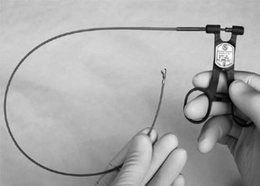
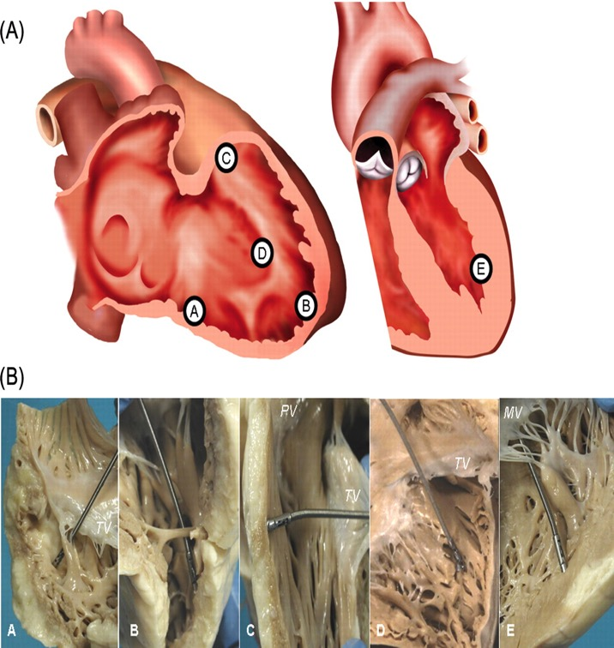
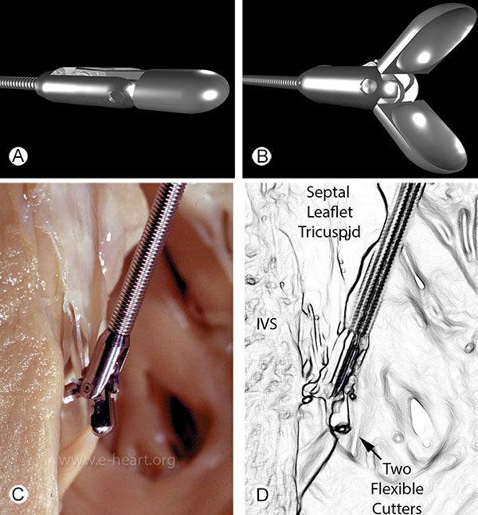
Bioptomes (left),
Areas of EMB sampling (right)

Slide 18
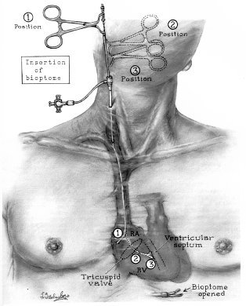
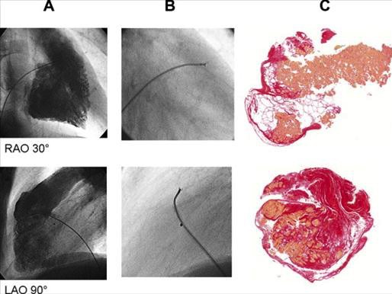

Slide 19
Results:
Once histological evaluation of a sample is complete, the reviewing pathologist will remark on the findings.
There are several histological diagnostic criteria to define myocarditis (and other diagnoses)
Dallas Criteria
WHO/ISPC Definition
Others

Slide 20
Risks?
General procedure-related complications:
Access-site pain/bleeding
Pneumothorax, arterial puncture, pulmonary embolization, nerve block or injury, hematoma, damage to the tricuspid valve, creation of arteriovenous fistula, and deep venous thrombosis.
Rare complications:
Cardiac puncture (occurs <1%, but if occurs it is often fatal)
Non-diagnostic results can suggest:
We missed the affected area of myocardium? Poor technique? Poor handling of sample after procedure? Or simply no evidence of myocarditis
Arrhythmia or conduction abnormalities may occur post-procedure

Slide 21
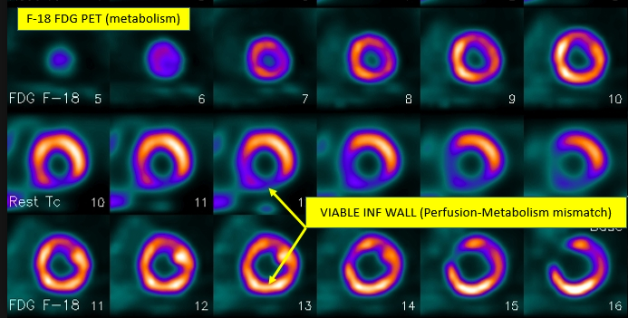
Cardiac PET Scan & SPECT Scan
The two main types of radionuclide myocardial perfusion imaging (rMPI)

Slide 22
General Indications for PET and SPECT:
To assess myocardial blood flow and/or tissue viability
→Looking for etiologies that would limit coronary flow (i.e. coronary artery stenosis), or evidence of myocardial ischemic changes (i.e. prior infarct).
Clinical Example:
When assessing etiology of heart failure (HF), consider:
Is there ischemic disease present? –
A “regional” wall abnormality seen on imaging suggesting prior infarct is highly suggestion of ischemic disease

Slide 23
Cardiac PET Scan
Cardiac positron emission tomography (PET) is an established, noninvasive method of evaluating myocardial perfusion and viability
Classified as a noninvasive nuclear imaging test.
PET assesses metabolically active tissue by administering a radiotracer isotope to the patient during a “rest” and “stress” phase
Positron-emitting isotopes (i.e. nitrogen-13, fluorine-18, etc.)
Providers can use myocardial viability findings in complement to anatomic information obtained with cardiac angiography (i.e. CTA)
This can be helpful in treatment planning:
I.e. planning CABG vs. stenting
Or post-CABG to determine if grafts are successfully perfusing appropriate portions of the myocardium

Slide 24
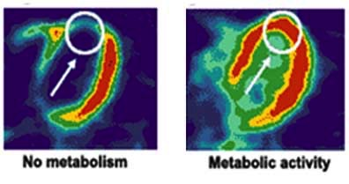
Single PET snapshot of metabolic activity

Slide 25
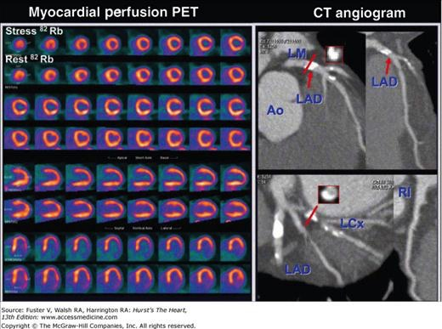
Looking for changes bw stress and rest phase; this is very helpful for planning purposes to try to assess the significance of the severity of the abnormality is

Slide 26
Areas of Strength (over other imaging modalities)
Myocardial PET scanning has the advantage of being able to assess both perfusion and metabolism.
How?
Ischemia shifts myocyte metabolism from glucose to fatty acids. Thus, uptake of a radioisotope-labeled glucose-analog by myocytes in an area of dysfunctional myocardium indicates metabolic activity and thus, viability.
Readioisotope is usually fluorine-18 labeled deoxyglucose (“FDG”)
Regional perfusion is assessed by demonstrating the distribution of blood flow in each coronary artery “water shed”.
As a result, PET imaging has the ability to differentiate between normal, “stunned” or “hibernating”, and necrotic myocardium
Stunned or hibernating = appearing as if they were suggestive of ischemia but in reality it is still having metabolic activity; necrotic will not have any of those

Slide 27
Basic Interpretation of PET Findings
The presence of the FDG-isotope uptake in regions showing metabolic activity but decreased blood flow (called "PET mismatch") defines hibernating or stunned myocardium by PET imaging
Those tissues are still likely viable.
Areas deemed to be “hibernating” or “stunned” have approximately an 80-85% chance of functional improvement following revascularization (cath)
A reduction in both metabolism and perfusion (called "PET match") is thought to represent predominantly necrotic myocardium.
Of note:
Myocardial segments with significant reductions in both blood flow and FDG uptake (“PET Match”) have only a 20% chance of functional improvement following revascularization.

Slide 28
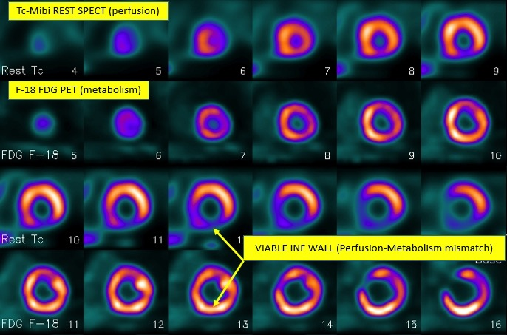
Example #1

Slide 29
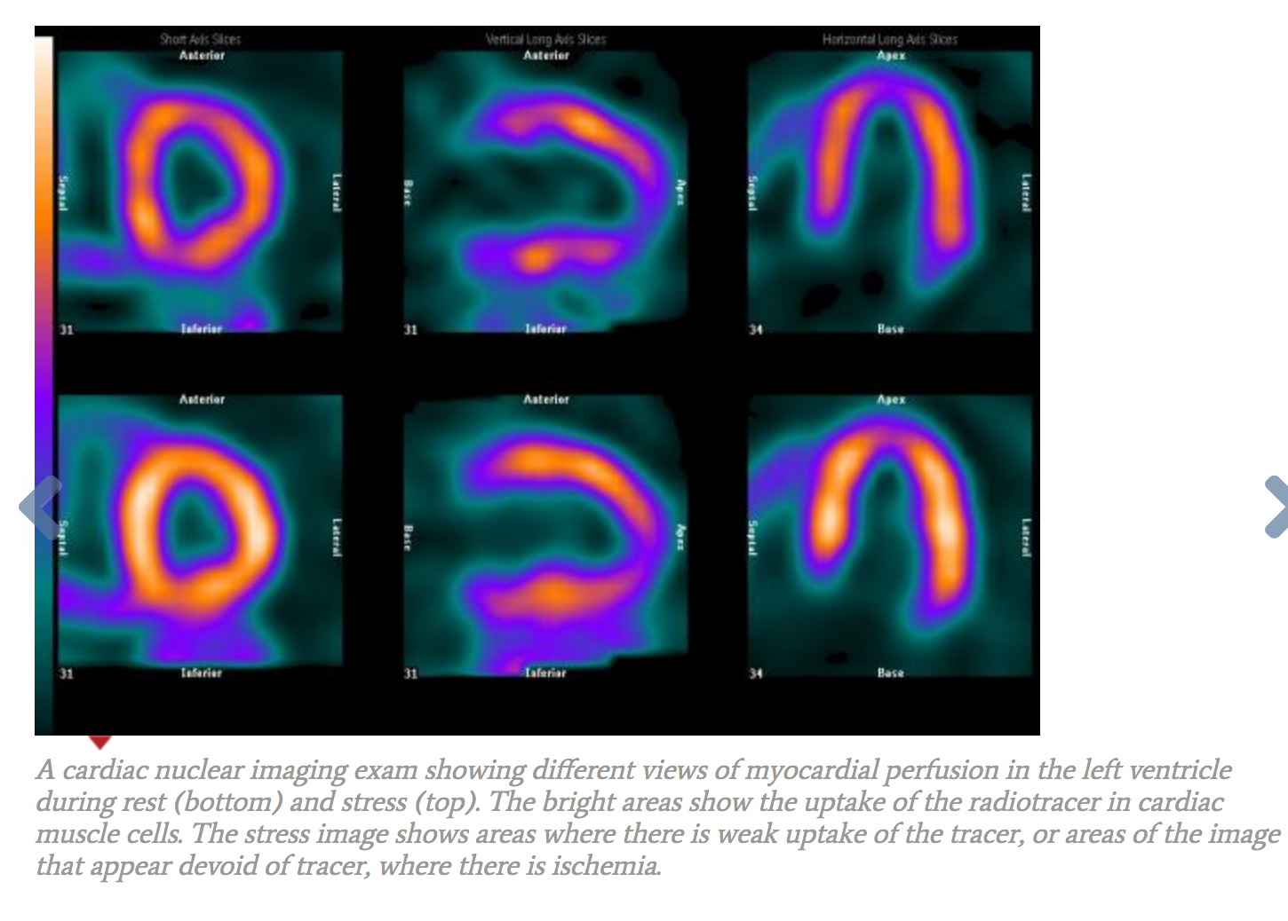
Example #2
Stress phase
Rest phase

Slide 30
Contraindications and Limitations?
PET is considered to be a generally safe diagnostic tool
NOTE: If there is a planned CT portion of the PET Scan, contraindications should be considered before IV contrast is utilized.
PET scans are not routinely recommended for women who may be pregnant but can be evaluated on a case-by-case basis.
Significantly overweight patients might have difficulties accessing the scanner or fitting into the scanner.
The test has a 92% sensitivity and 85% specificity for diagnosing CAD when evaluating stenosis of 50% or greater
Less than 50%, it will not be as sensitive or specific
Notes:
https://www.cedars-sinai.edu/Patients/Programs-and-Services/Imaging-Center/For-Physicians/Cardiac-Imaging/Cardiac-PET/PET-and-PET-CT-Contraindications.aspx

Slide 31
SPECT Scan (Nuclear Imaging)
“Single Photon Emission Computed Tomography” = (SPECT)
SPECT is a noninvasive nuclear imaging test, which uses radioactive tracers that are injected via IV to produce diagnostic images.
Typically uses either thallium (T-201) or technetium (Tc-99m) radioisotopes.
(SPECT) is performed with the heart at stress and at rest.
The two image sets are compared to determine whether areas of absent perfusion (defects) on the stress images are permanent or transient.
Permanent defects imply areas of infarct/scarring, while transient or reversible defects suggest ischemia.

Slide 32
Basic Interpretation
A special “gamma” camera picks up signals from the tracer as it moves over the heart. The tracer’s signals are converted into images.
Normal myocardium appears “hot” (red or bright), and ischemic or infarcted areas “cold” (blue or dark).
Acute MI (< 12 h) can still be seen as a hotspot
Why? Because tissue is still potentially viable after acute MI
Old MI / scar tissue is seen as “cold" on both resting and exercise scans.
Why? Tissue is no longer viable
Ischemia is seen as normal on rest scan and cold on exercise scan
Examples on next few slides

Slide 33
Advantages/Disadvantages
Provides more information that ECG alone during stress test
The advantages of SPECT imaging include widespread availability, and strong research data and literature supporting its use.
SPECT has 87% sensitivity, and 73% specificity for detecting greater than 50% stenosis
Sensitivity and specificity lower than PET
Limitations include:
Artifact due to body habitus (i.e. obese patients) that limit sensitivity and specificity,
Limited utility for showing extent of underlying CAD,
LVEF not being measured at peak stress.
Notes:
LVEF = left ventricular ejection fraction
http://www.cathlabdigest.com/articles/Non-Invasive-Tests-Imaging-Modalities-Role-Management-CCL-Patients

Slide 34
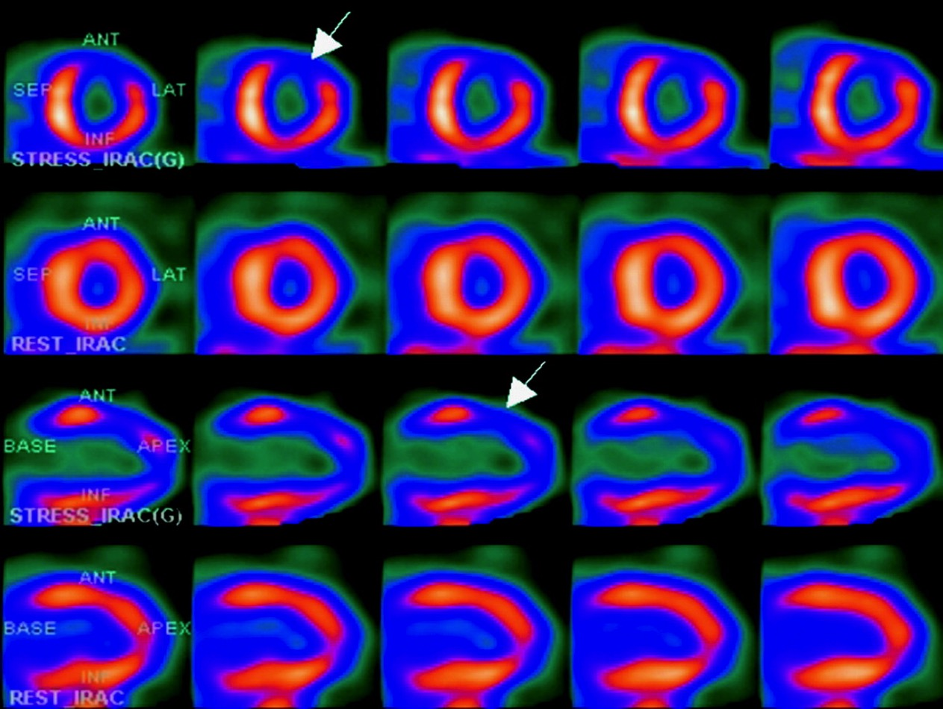
Example #1
Bright/hot areas = viable myocardium/normal
Cooler areas around it = abnormal
Stress
Rest
Concerning for a flow limiting lesion during stress test
Stress
Rest

Slide 35
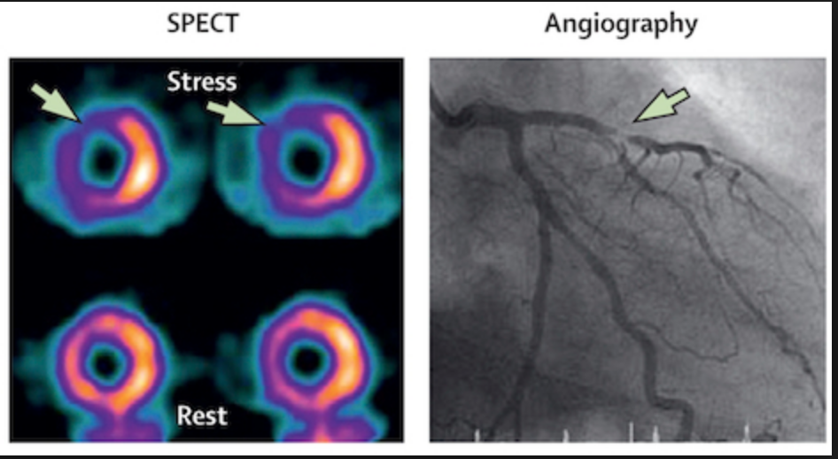
Example #2
Suggested lesion here when comparing rest vs stress

Slide 36
PET vs. SPECT Scanning
Both can be used for “viability” studies
It remains unclear if PET is more useful than SPECT for viability assessments.
In either case the information can be used to determine if PCI or CABG is feasible or necessary (if tissue is viable)
Some studies, including one randomized trial, found that the ability to detect myocardial viability with PET or SPECT imaging was the same and that there was no difference in patient outcome when management decisions were based upon the results of either technique (citation below).
The main advantages of SPECT are that it is more widely available and less expensive than than PET.
SPECT, however, has limitations including longer scan times and lower-resolution images prone to artifacts.
Artifact could be misidentified as a perfusion defect
Notes:
No difference in cardiac event-free survival between positron emission tomography-guided and single-photon emission computed tomography-guided patient management: a prospective, randomized comparison of patients with suspicion of jeopardized myocardium.
Siebelink HM, Blanksma PK, Crijns HJ, Bax JJ, van Boven AJ, Kingma T, Piers DA, Pruim J, Jager PL, Vaalburg W, van der Wall.
J Am Coll Cardiol. 2001;37(1):81.
https://www.dicardiology.com/article/spect-scanner-vs-pet-which-best

Slide 37
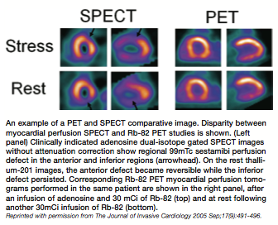

Slide 38
Debate Summary:
Currently, SPECT and PET are very similar, and data doesn’t warrant recommending one over the other for general purposes
In the next few years, however, as these technologies improve one will likely arise as the clear first-line imaging.
Because SPECT is more commonly utilized due to it’s broader availability and less expensive nature, you will likely see this more often in real-world practice.

Slide 39
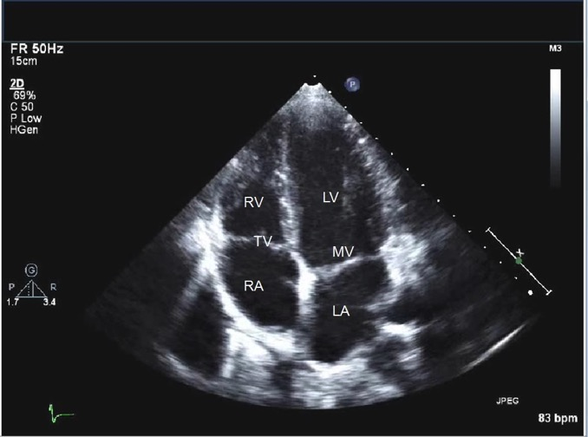
Topic Overview:
Cardiac Echocardiography

Slide 40
General Indications:
Assess left ventricular size, volume, systolic /diastolic function, and movement for abnormalities for signs of pathology
Such as:
Congestive heart failure
Wall motion abnormality post-MI (due to necrosis or scarring)
Cardiomyopathies (i.e. hypertrophic, ischemic, dilated)
Assess valvular function for abnormalities
Such as:
Stenosis
Regurgitation
Assess prosthetic valves
Look for vegetations, function, failure, etc.

Slide 41
Complaints that might warrant an ECHO:
If a patient complains of:
SOB/dyspnea (particularly on exertion) and you believe cardiac causes cannot be ruled out by CXR, ECG, or labs alone.
Paroxsysmal noctural dyspnea or orthopnea.
Lower extremity edema of unexplained source
Unexplained syncope
(particularly in young pt w/suspicion for HCM)
Recurrent palpitations, particularly if other symptoms exist

Slide 42
Other indications:
Assess LV function and evaluate for LVH in a pt with long-standing HTN
Assess new-onset murmurs, S3/S4 gallops, friction rubs, enlarged PMI, JVD, or other abnormal findings suggestive of structural or valvular disease.
Recent stroke (of unexplained etiology) to evaluate for cardiogenic source
Assess for congenital or structural heart disease (i.e. ASD, PFO, etc.)
Assess for myxoma

Slide 43
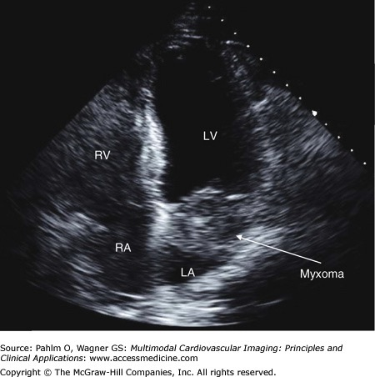

Slide 44
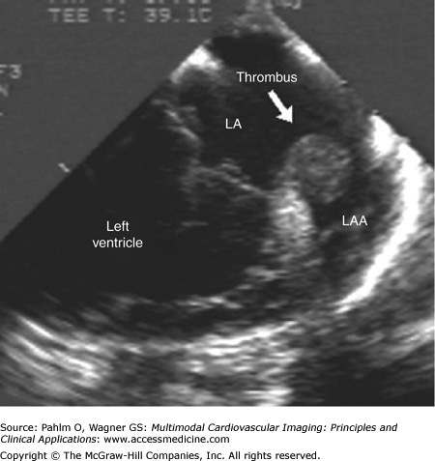
Left atrial thrombus. Transesophageal echocardiographic image of a dilated left atrium and large left atrial thrombus. LA, left atrium; LAA, left atrial appendage.

Slide 45
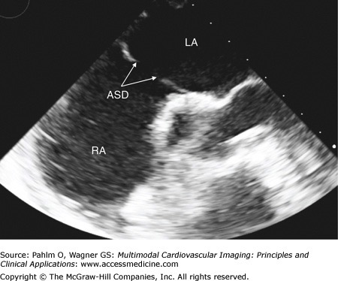

Slide 46
Transthoracic (TTE) vs. Transesophageal (TEE)
TTE remains the initial test of choice for most patients requiring an echocardiogram.
TEE usually provides superior image quality, particularly for posterior cardiac structures which are nearer to the esophagus.
Because of its moderately invasive nature, however, TEE is reserved for selected indications in which the potential benefits of making a diagnosis outweigh the risks associated with the procedure.
For many clinical situations, a TTE study precedes the TEE

Slide 47
TEE Summary-
TEE is most commonly performed to evaluate for:
A potential cardiac source of embolus,
To assess valves for endocarditis,
Or to exclude left atrial appendage (LAA) thrombi in pts w/ a-fib, particularly when prior to cardioversion (esp. if TTE was “normal”)
Assess for prosthetic heart valve dysfunction
Assess severity of native valvular disease
Note: Thoracic MRI and CT have largely replaced TEE for assessment of aortic aneurysm/dissection.

Slide 48
References:
https://www.uptodate.com/contents/endomyocardial-biopsy
https://www.uptodate.com/contents/clinical-manifestations-and-diagnosis-of-myocarditis-in-adults
https://www.uptodate.com/contents/invasive-cardiac-electrophysiology-studies
https://www.uptodate.com/contents/transesophageal-echocardiography-indications-complications-and-normal-views
Bashore TM, Granger CB, Jackson KP, Patel MR. Heart Disease. In: Papadakis MA, McPhee SJ, Rabow MW. eds. Current Medical Diagnosis & Treatment 2017. New York, NY: McGraw-Hill; 2016.
Crawford MH. Chapter 5. Approach to Cardiac Disease Diagnosis. In: Crawford MH. eds. Current Diagnosis & Treatment: Cardiology, 4e. New York, NY: McGraw-Hill; 2014.
Goldman ME. Pericardiocentesis. In: Oropello JM, Pastores SM, Kvetan V. eds. Critical Care. New York, NY: McGraw-Hill; 2016.
Gomella LG, Haist SA. Chapter 15. Imaging Studies. In: Gomella LG, Haist SA. eds. Clinician's Pocket Reference: The Scut Monkey, 11e. New York, NY: McGraw-Hill; 2007. LeBlond RF, Brown DD, Suneja M, Szot JF. Common Laboratory Tests. In: LeBlond RF, Brown DD, Suneja M, Szot JF. eds. DeGowin’s Diagnostic Examination, 10e. New York, NY: McGraw-Hill; 2015.
Hongo RH, Goldschlager NF. Chapter 14. Conduction Disorders & Cardiac Pacing. In: Crawford MH. eds. Current Diagnosis & Treatment: Cardiology, 4e. New York, NY: McGraw-Hill; 2014.
Kern MJ, King SB, III. Chapter 19. Cardiac Catheterization, Cardiac Angiography, and Coronary Blood Flow and Pressure Measurements. In: Fuster V, Walsh RA, Harrington RA. eds. Hurst's The Heart, 13e. New York, NY: McGraw-Hill; 2011.
Pahlm O., Wagner, G. Multimodal Cardiovascular Imaging: Principles and Clinical Applications. McGraw Hill, 2011.

Slide 49
That’s all!
Questions?
ewald@musc.edu

